Slide 1

GUVI Multilingual QA Chatbot
Multilingual assistant for GUVI
Prepared by
GAJAPRIYA GOWTHAM

Slide 2

Project Overview
A Multilingual chatbot to answer queries about GUVI’s platform, courses, and features.
Supports multiple languages using RAG (Retrieval-Augmented Generation) and NLLB-based translation.
Key highlights:
- Multilingual support
- Context-based answers
- Lightweight text generation
- Interactive interface

Slide 3

Objectives
Understand and respond in multiple languages
Provide accurate, context-aware answers
Integrate translation + retrieval + generation
Deploy for real-time interaction

Slide 4

Features
Multilingual support (Indian + global languages)
FAISS + SentenceTransformer for context retrieval
NLLB-200 translation for input/output
LaMini-Flan-T5-783M for answer generation
Gradio-based interactive UI
Robust error handling

Slide 5

Tools & Technologies
Python
Hugging Face Transformers
Sentence Transformers
FAISS (Vector Search)
NLLB-200 (Translation)
Gradio (UI)
NLTK (Text Preprocessing)

Slide 6

How It Works (Flowchart)
User input → Language detection → Translation (if needed)
Embedding generation → FAISS retrieval → Prompt creation
Text generation → Back translation → Display answer
Optional: Use a simple flow diagram with arrows.

Slide 7

Steps Taken
Collected content from GUVI, Shiksha, Scribd, ChatGPT, Perplexity
Cleaned and chunked text using NLTK
Generated embeddings, built FAISS index
Designed RAG pipeline
Integrated with Gradio interface
Deployed on Hugging Face Spaces

Slide 8

Use Cases
Instant student support for GUVI courses
Course recommendations based on queries
Quick access to GUVI knowledge base
24/7 multilingual assistance
Interactive, accessible learning worldwide

Slide 9
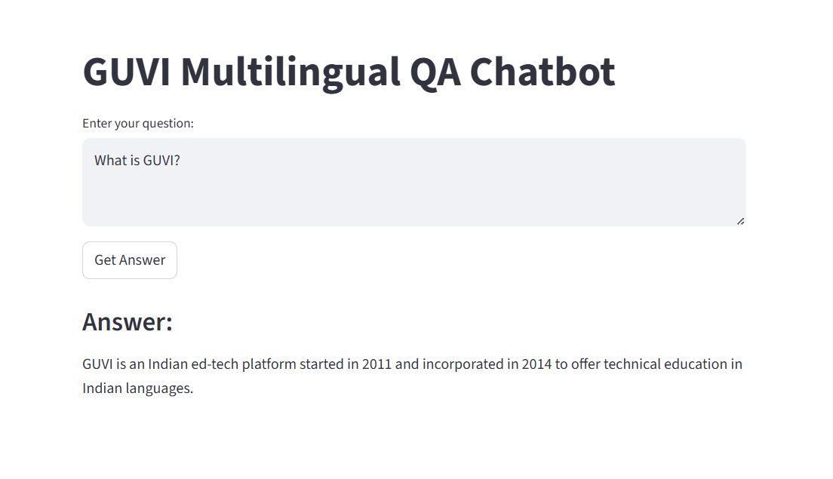
Demo - English
English Output

Slide 10
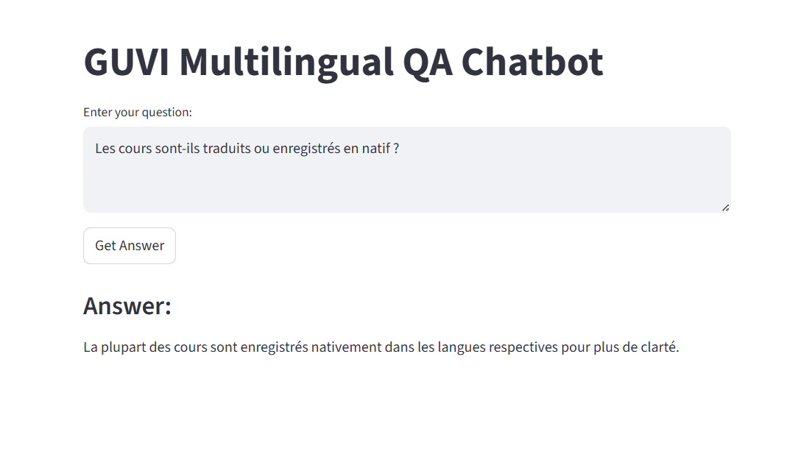
Demo - French
French Output

Slide 11
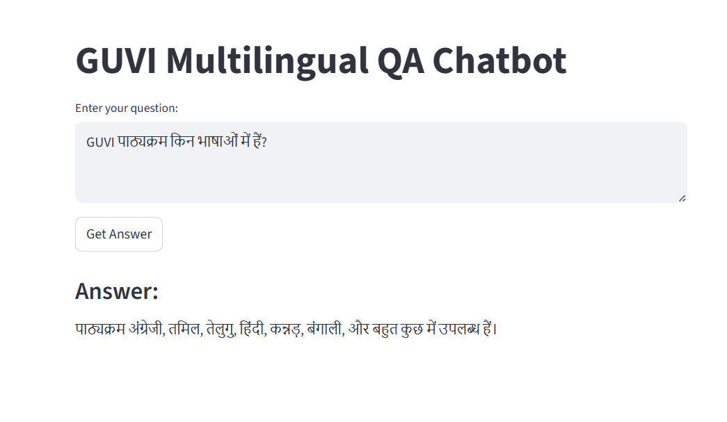
Demo - Hindi
Hindi Output

Slide 12
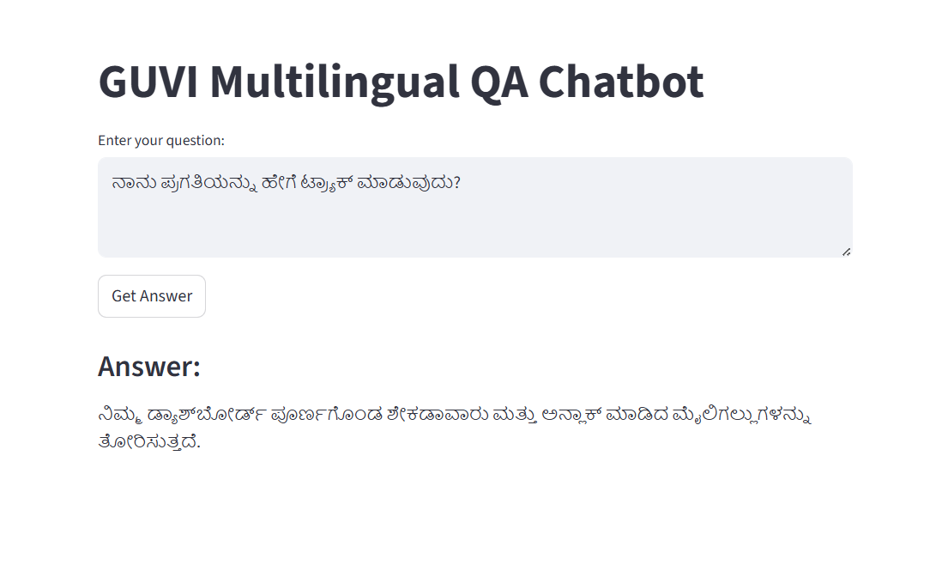
Demo - Kannada
Kannada Output

Slide 13
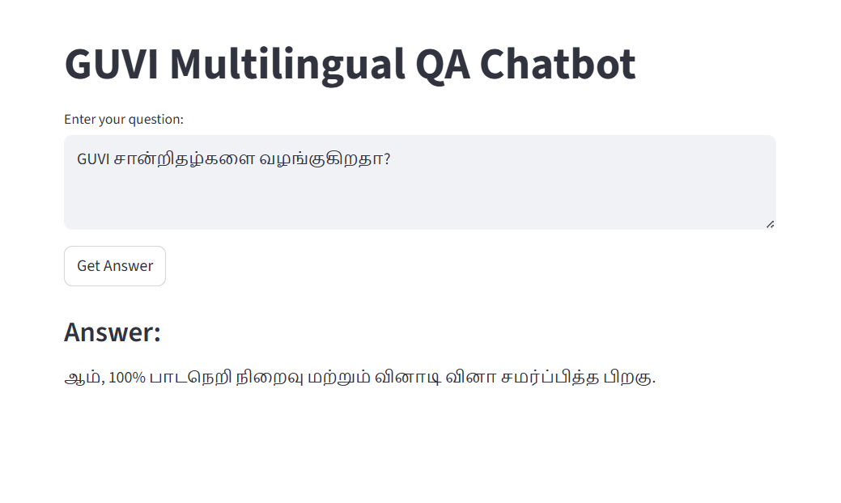
Demo - Tamil
Tamil Output

Slide 14

Conclusion
Demonstrates practical use of RAG with multilingual translation.
Improves accessibility, speeds up information retrieval, and enhances user experience.

